Slide 1

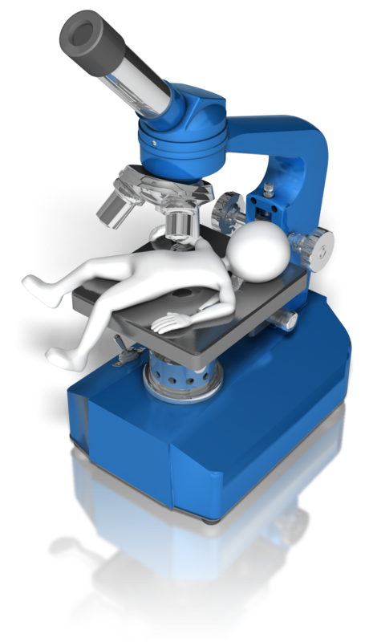


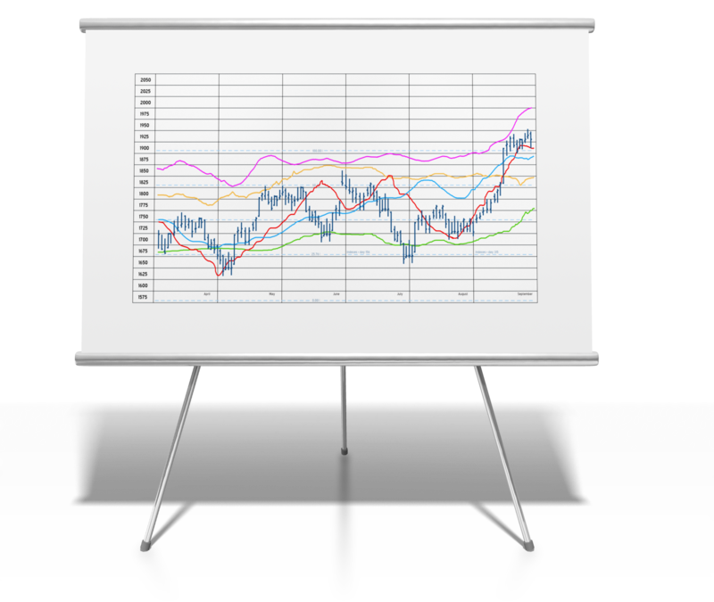

Quality Improvement Ecosystem
GUIDELINES (Professional Societies, CDC, etc.)
What SHOULD happen. What do we want to happen? Includes diagrams, terminology and expression logic for incorporation into clinical workflow and process and outcome evaluation measures.
RESEARCH, PAYER AND PUBLIC HEALTH SURVEILLANCE
What is ACTUALLY happening and why?
CLINICAL DECISION SUPPORT
MAKING it happen within local workflow.
Patient, provider, population, public
REPORTING
Quality
Safety
MEASUREMENT ANALYTICS
What DID happen? What processes and outcomes have been achieved?

Slide 2
Quality Improvement Ecosystem
Quality Improvement Ecosystem
CLINICAL DECISION SUPPORT
RESEARCH, PAYER & PUBLIC HEALTH SURVEILLANCE
GUIDELINES
(Professional Societies, CDC, etc.)
MAKING it happen within local workflow.
What is ACTUALLY happening and why?
What SHOULD happen. What do we want to happen?
Patient, provider, population, public
REPORTING
Public Health
Quality
Safety
MEASUREMENT ANALYTICS
What DID happen? What processes and outcomes have been achieved?

